Slide 1
4-1 Euclidean Inner Product
Definition
If u = (u₁ ,u₂ ,…,u_{n}), v = (v₁ ,v₂ ,…, v_{n}) are vectors in R^{n}, then the Euclidean inner product u · v is defined by
u · v = u₁ v₁ + u₂ v₂ + … + u_{n} v_{n}
Example 1
The Euclidean inner product of the vectors u = (-1,3,5,7) and v = (5,-4,7,0) in R⁴ is
u · v = (-1)(5) + (3)(-4) + (5)(7) + (7)(0) = 18
*
Elementary Linear Algebra
‹#›

Slide 2
Theorem 4.1.2 Properties of Euclidean Inner Product
If u, v and w are vectors in R^{n} and k is any scalar, then
u · v = v · u
(u + v) · w = u · w + v · w
(k u) · v = k(u · v)
v · v ≥ 0; Further, v · v = 0 if and only if v = 0
*
‹#›

Slide 3
4-1 Example 2
(3u + 2v) · (4u + v) = (3u) · (4u + v) + (2v) · (4u + v ) = (3u) · (4u) + (3u) · v + (2v) · (4u) + (2v) · v =12(u · u) + 11(u · v) + 2(v · v)
*
Elementary Linear Algebra
‹#›

Slide 4
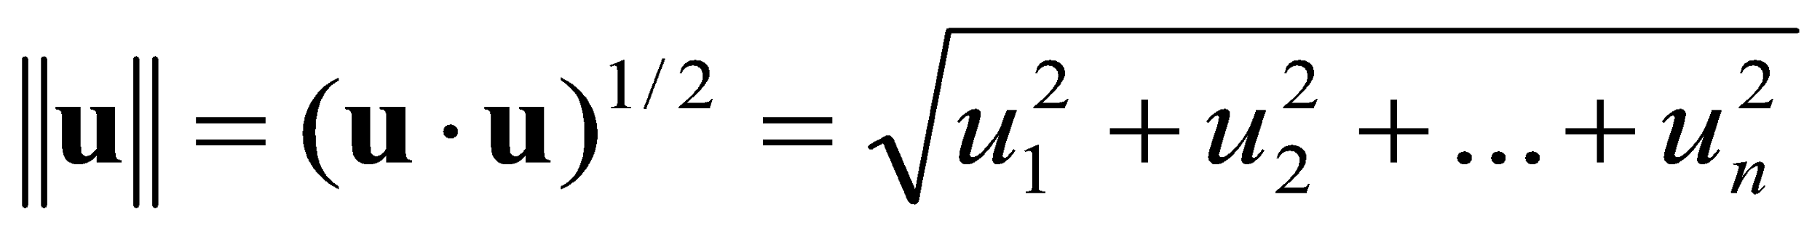
4-1 Norm and Distance in Euclidean n-Space
We define the Euclidean norm (or Euclidean length) of a vector u = (u₁ ,u₂ ,…,u_{n}) in R^{n} by
Similarly, the Euclidean distance between the points u = (u₁ ,u₂ ,…,u_{n}) and v = (v₁ , v₂ ,…,v_{n}) in R^{n} is defined by
*
Elementary Linear Algebra
‹#›

Slide 5
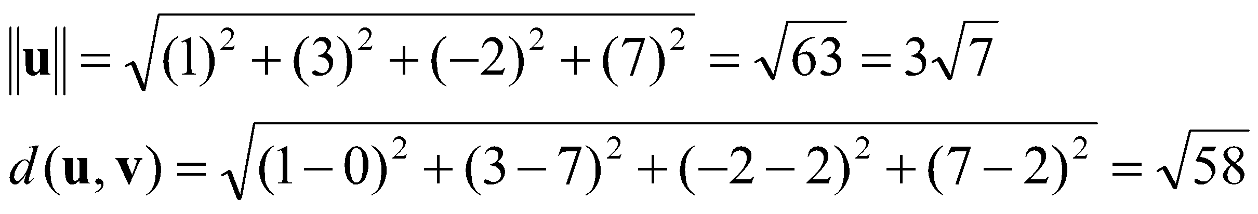
4-1 Example 3
Example
If u = (1,3,-2,7) and v = (0,7,2,2), then in the Euclidean space R⁴
*
Elementary Linear Algebra
‹#›

Slide 6
Theorem 4.1.3 (Cauchy-Schwarz Inequality in R^{n})
If u = (u₁ ,u₂ ,…,u_{n}) and v = (v₁ , v₂ ,…,v_{n}) are vectors in R^{n}, then |u · v| ≤ || u || || v ||
*
Elementary Linear Algebra
‹#›

Slide 7
Theorem 4.1.4 (Properties of Length in R^{n})
If u and v are vectors in R^{n} and k is any scalar, then
|| u || ≥ 0
|| u || = 0 if and only if u = 0
|| ku || = | k ||| u ||
|| u + v || ≤ || u || + || v || (Triangle inequality)
*
Elementary Linear Algebra
‹#›

Slide 8
Theorem 4.1.5 (Properties of Distance in R^{n})
If u, v, and w are vectors in R^{n} and k is any scalar, then
d(u, v) ≥ 0
d(u, v) = 0 if and only if u = v
d(u, v) = d(v, u)
d(u, v) ≤ d(u, w ) + d(w, v) (Triangle inequality)
*
Elementary Linear Algebra
‹#›

Slide 9
Theorem 4.1.6
If u, v, and w are vectors in R^{n} with the Euclidean inner product, then u · v = ¼ || u + v ||²–¼ || u–v ||²
*
Elementary Linear Algebra
‹#›

Slide 10
4-1 Orthogonality
Two vectors u and v in R^{n} are called orthogonal if u · v = 0
Example 4
In the Euclidean space R⁴ the vectors
u = (-2, 3, 1, 4) and v = (1, 2, 0, -1)
are orthogonal, since
u · v = (-2)(1) + (3)(2) + (1)(0) + (4)(-1) = 0
*
Elementary Linear Algebra
‹#›

Slide 11
Theorem 4.1.7 (Pythagorean Theorem in R^{n})
If u and v are orthogonal vectors in R^{n} which the Euclidean inner product, then || u + v ||² = || u ||² + || v ||²
*
Elementary Linear Algebra
‹#›

Slide 12
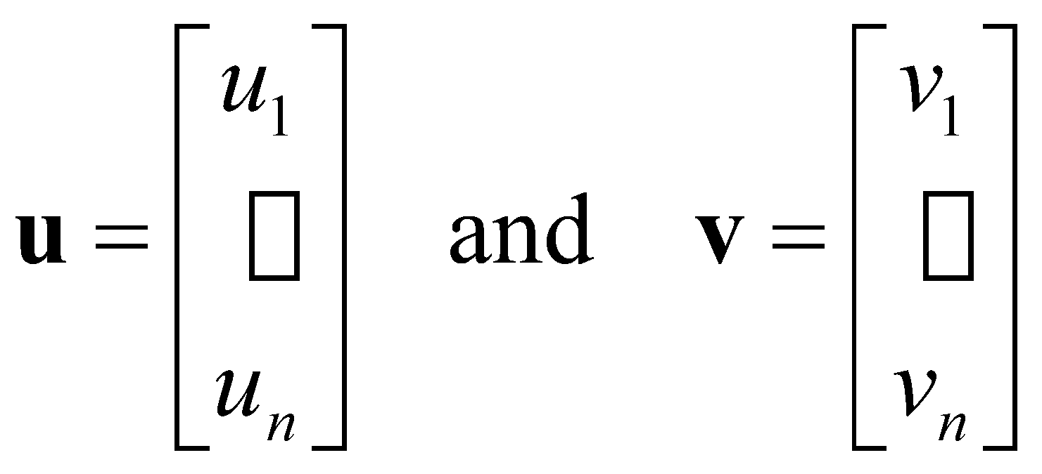
4-1 Matrix Formulae for the Dot Product
If we use column matrix notation for the vectors
u = [u₁ u₂ … u_{n}]^{T} and v = [v₁ v₂ … v_{n}]^{T} ,
or
then
u · v = v^{T}u
Au · v = u · A^{T}v
u · Av = A^{T}u · v
*
Elementary Linear Algebra
‹#›

Slide 13
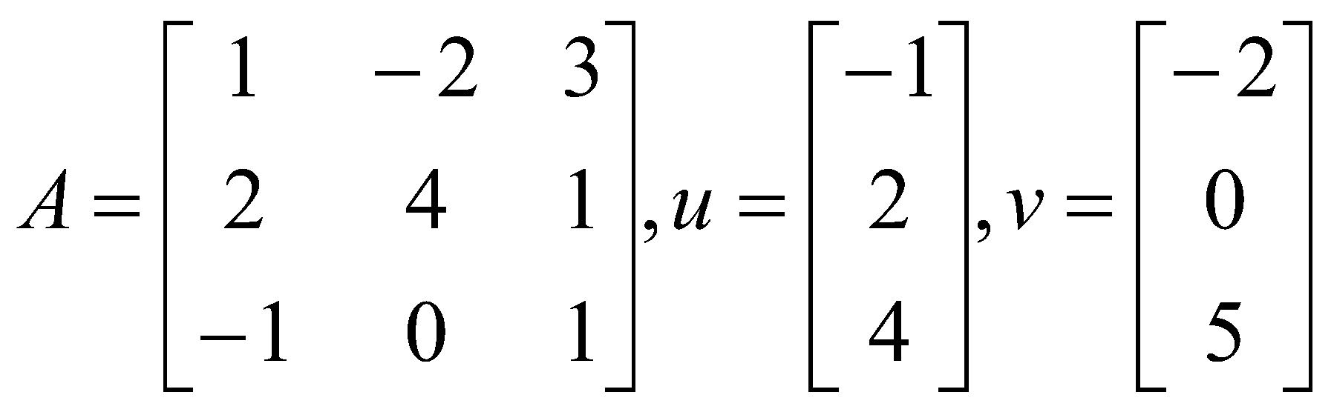
4-1 Example 5
Verifying that Au‧v= u‧A^{t}v
*
Elementary Linear Algebra
‹#›

Slide 14
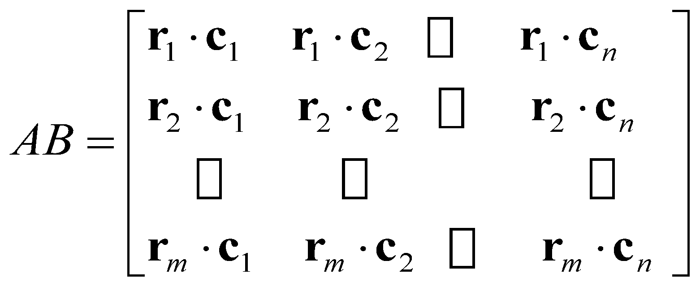
4-1 A Dot Product View of Matrix Multiplication
If A = [a_{ij}] is an m×r matrix and B =[b_{ij}] is an r×n matrix, then the ij-the entry of AB is
a_{i1}b_{1j} + a_{i2}b_{2j} + a_{i3}b_{3j} + … + a_{ir}b_{rj}
which is the dot product of the ith row vector of A and the jth column vector of B
Thus, if the row vectors of A are r₁, r₂, …, r_{m} and the column vectors of B are c₁, c₂, …, c_{n} ,
*
Elementary Linear Algebra
‹#›

Slide 15
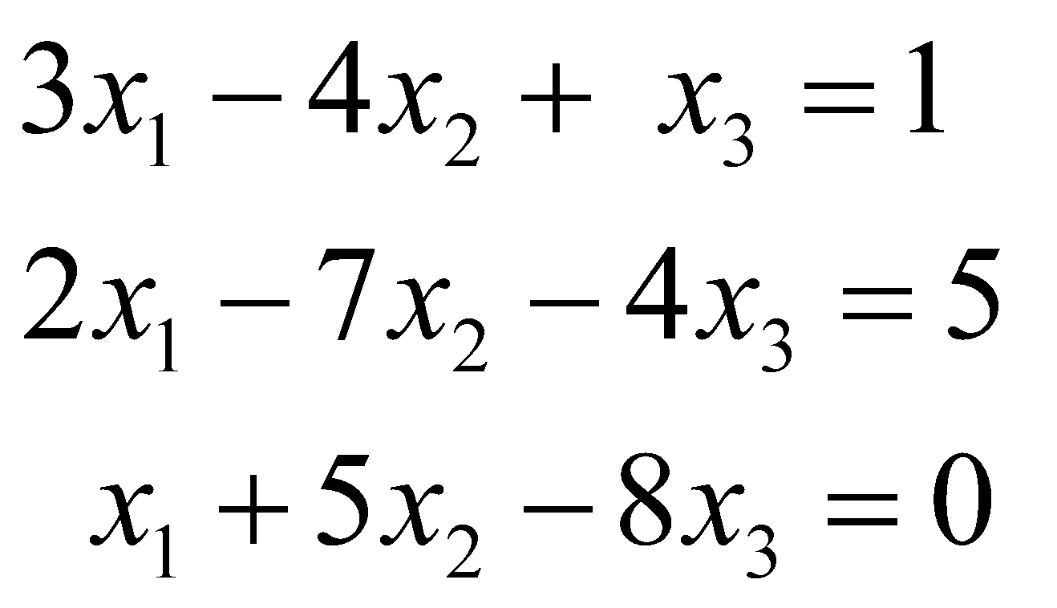
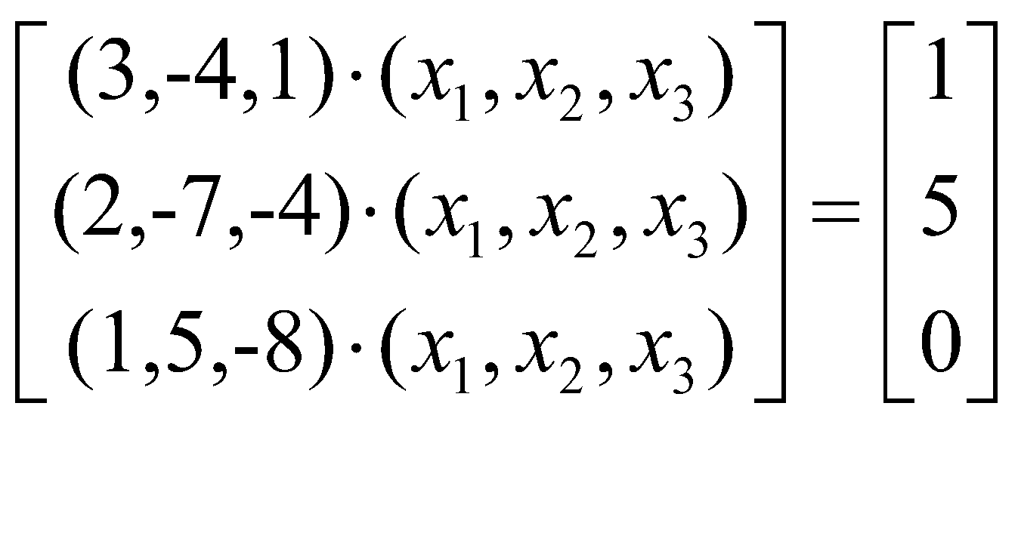
4-1 Example 6
A linear system written in dot product form
system dot product form
*
Elementary Linear Algebra
‹#›

Slide 16
Chapter Content
Euclidean n-Space
Linear Transformations from R^{n} to R^{m}
Properties of Linear Transformations R^{n} to R^{m}
Linear Transformations and Polynomials
*
Elementary Linear Algebra
‹#›

Slide 17
4-2 Functions from R^{n} to R
A function is a rule f that associates with each element in a set A one and only one element in a set B.
If f associates the element b with the element, then we write b = f(a) and say that b is the image of a under f or that f(a) is the value of f at a.
The set A is called the domain of f and the set B is called the codomain of f.
The subset of B consisting of all possible values for f as a varies over A is called the range of f.
*
Elementary Linear Algebra
‹#›

Slide 18
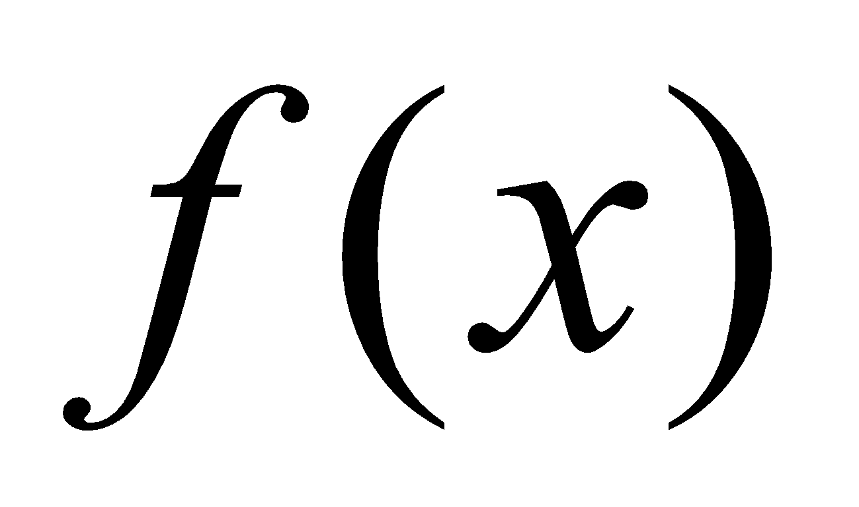
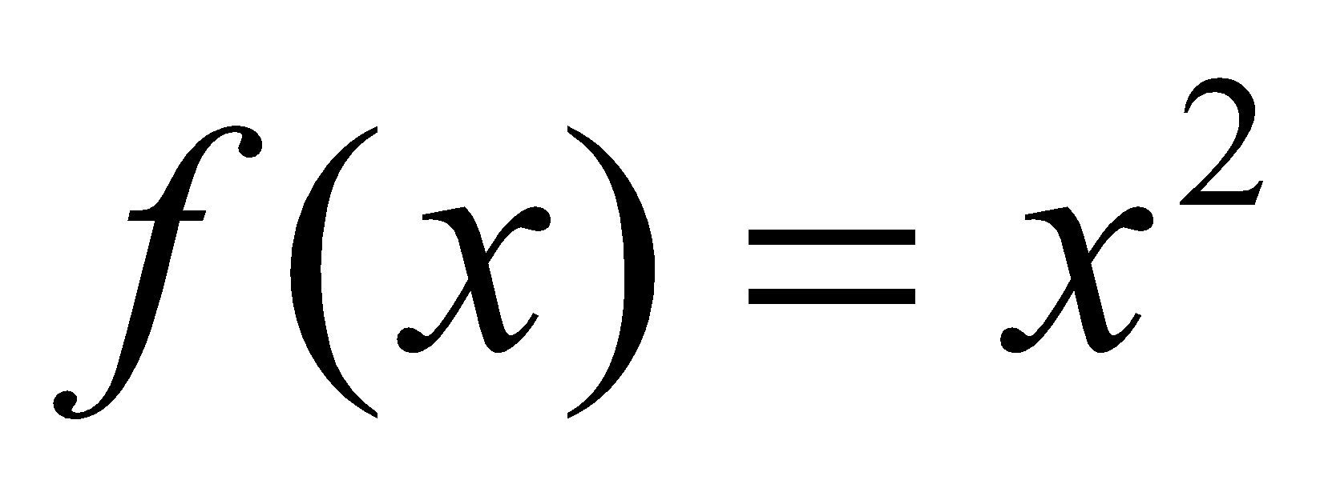
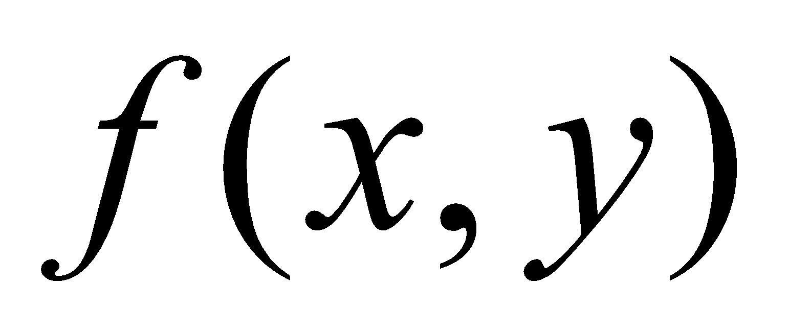
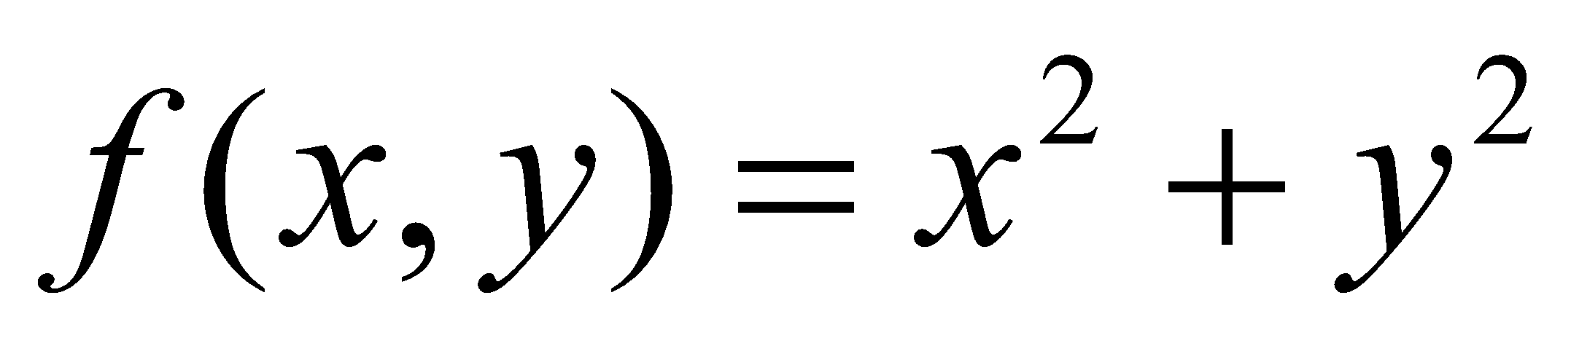
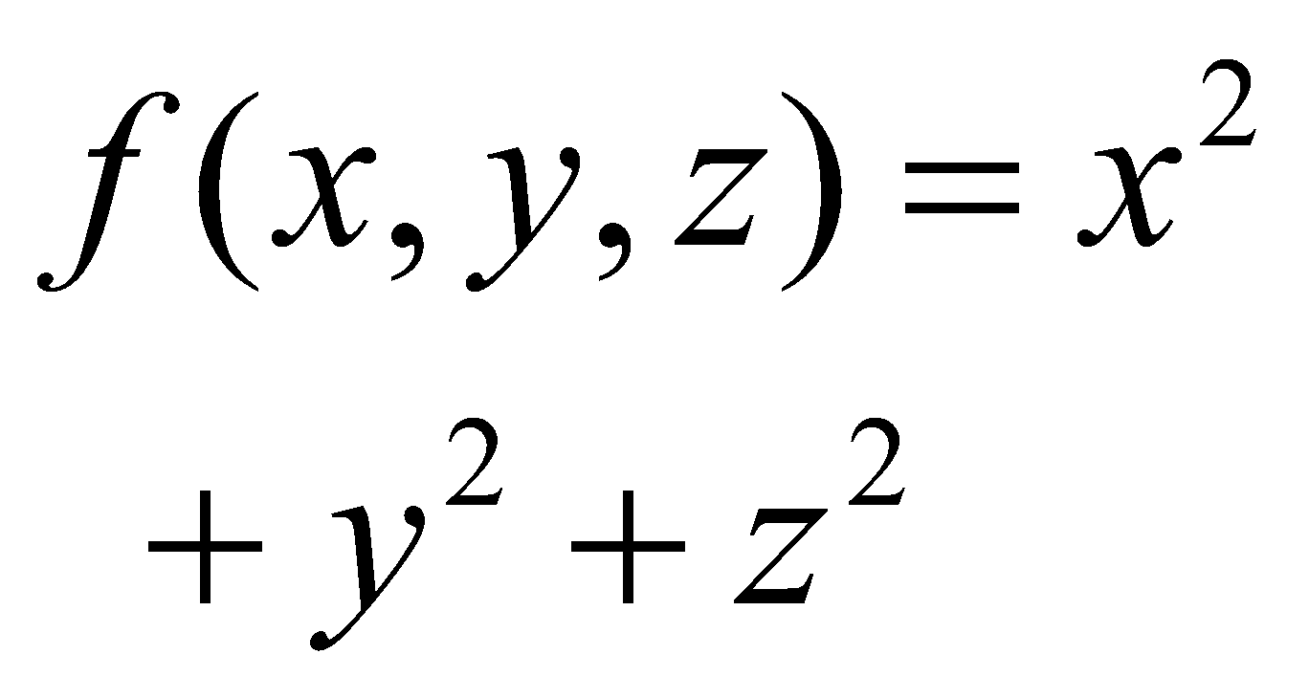
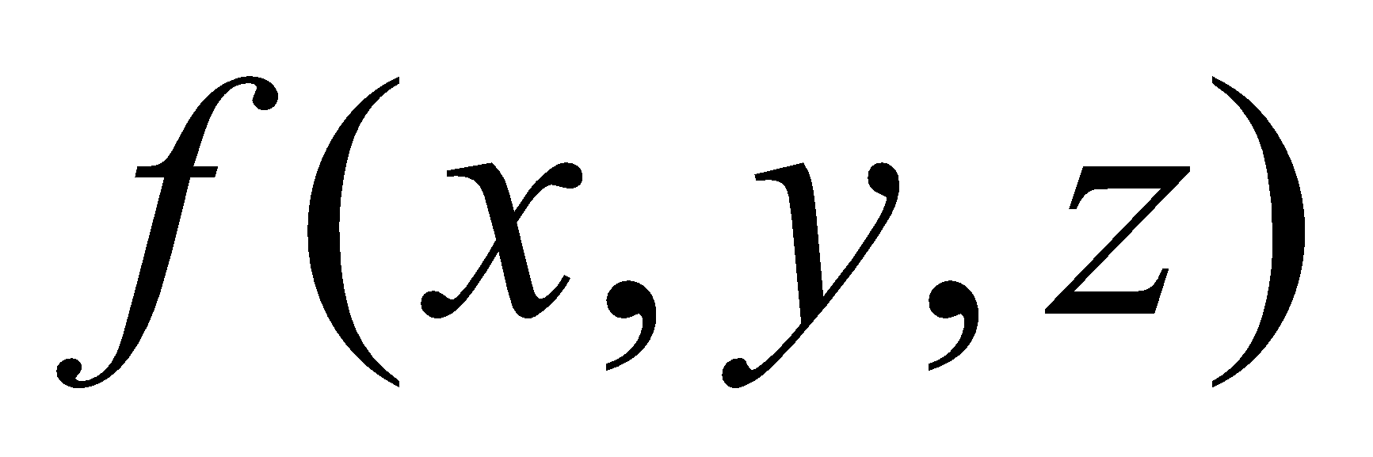
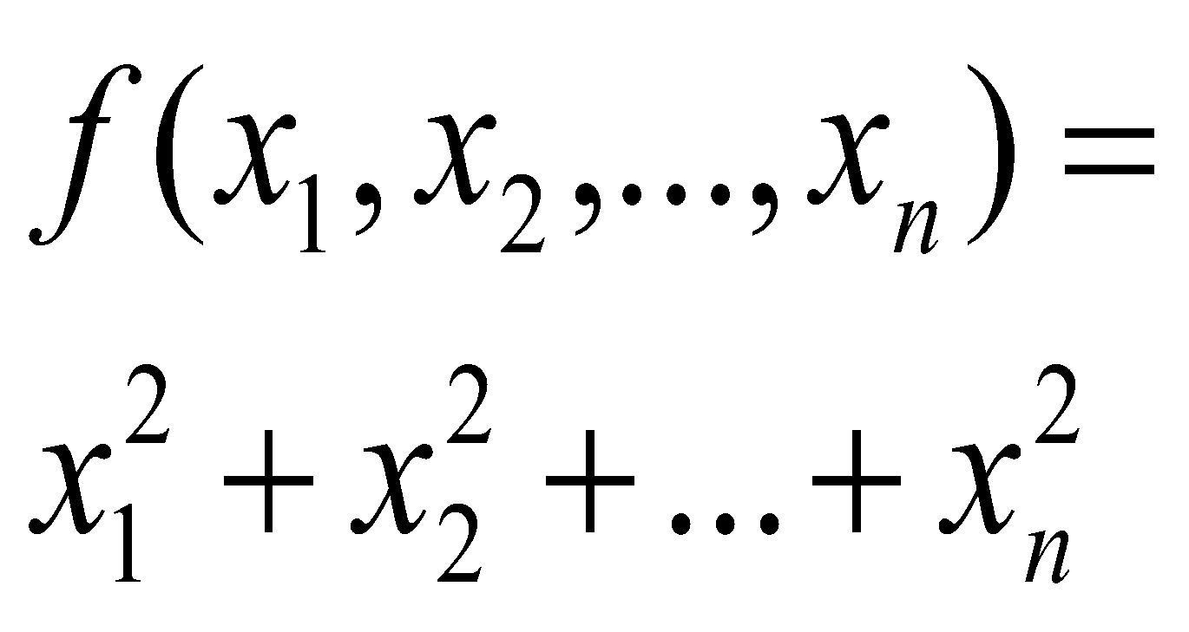
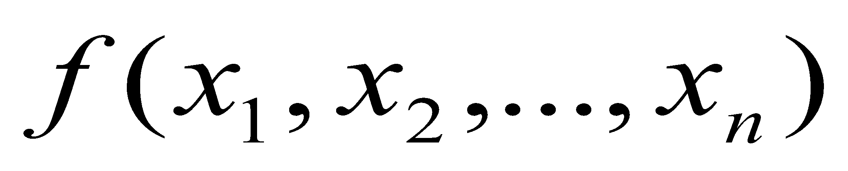
4-2 Examples
Formula | Example | Classification | Description
 |  | Real-valued function of a real variable | Function from R to R
 |  | Real-valued function of two real variable | Function from R² to R
 |  | Real-valued function of three real variable | Function from R³ to R
 |  | Real-valued function of n real variable | Function from R^{n} to R
*
Elementary Linear Algebra
‹#›

Slide 19
4-2 Function from R^{n} to R^{m}
If the domain of a function f is R^{n} and the codomain is R^{m}, then f is called a map or transformation from R^{n} to R^{m}. We say that the function f maps R^{n} into R^{m}, and denoted by f : R^{n} → R^{m}.
If m = n the transformation f : R^{n} → R^{m} is called an operator on R^{n}.
Suppose f₁, f₂, …, f_{m} are real-valued functions of n real variables, say
w₁ = f₁(x₁,x₂,…,x_{n})
w₂ = f₂(x₁,x₂,…,x_{n})
…
w_{m} = f_{m}(x₁,x₂,…,x_{n})
These m equations define a transformation from R^{n} to R^{m}. If we denote this transformation by T: R^{n} → R^{m} then
T (x₁,x₂,…,x_{n}) = (w₁,w₂,…,w_{m})
*
Elementary Linear Algebra
‹#›

Slide 20
4-2 Example 1
The equations
w₁ = x₁ + x₂
w₂ = 3x₁x₂
w₃ = x₁² – x₂²
define a transformation T: R² → R³.
T(x₁, x₂) = (x₁ + x₂, 3x₁x₂, x₁² – x₂²)
Thus, for example, T(1,-2) = (-1,-6,-3).
*
Elementary Linear Algebra
‹#›

Slide 21
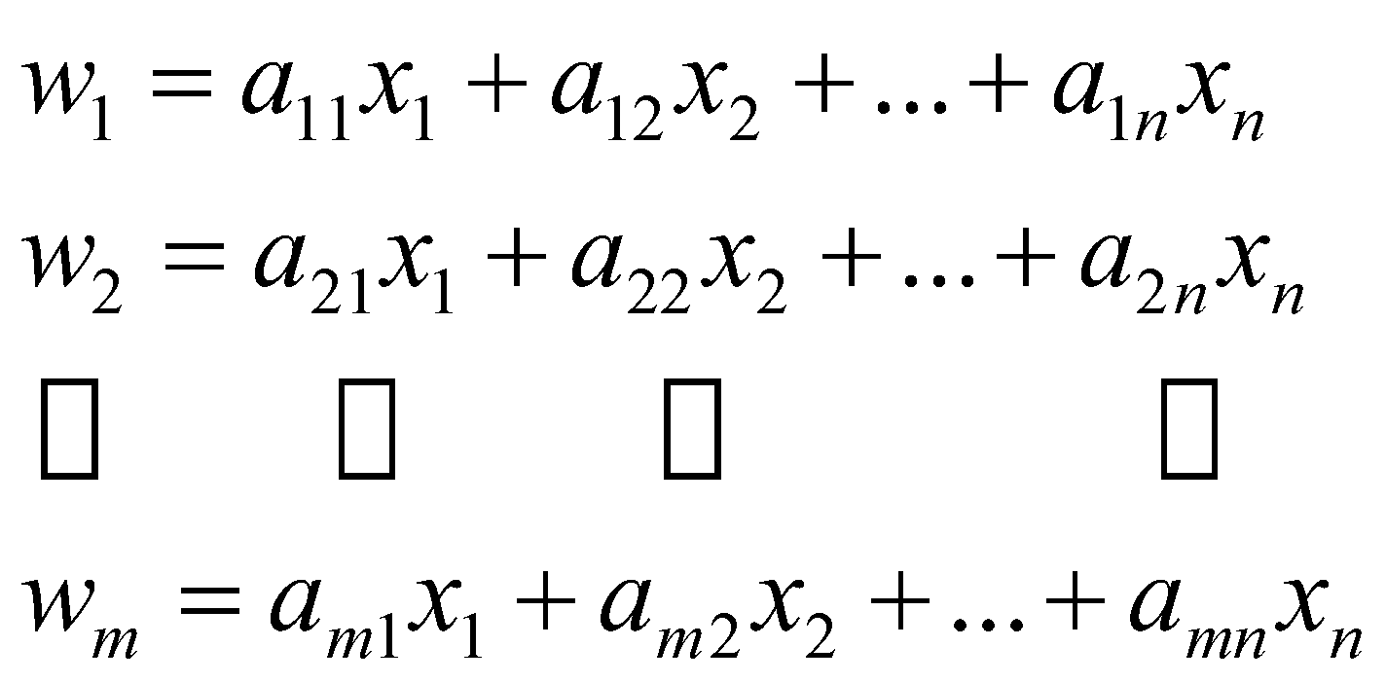
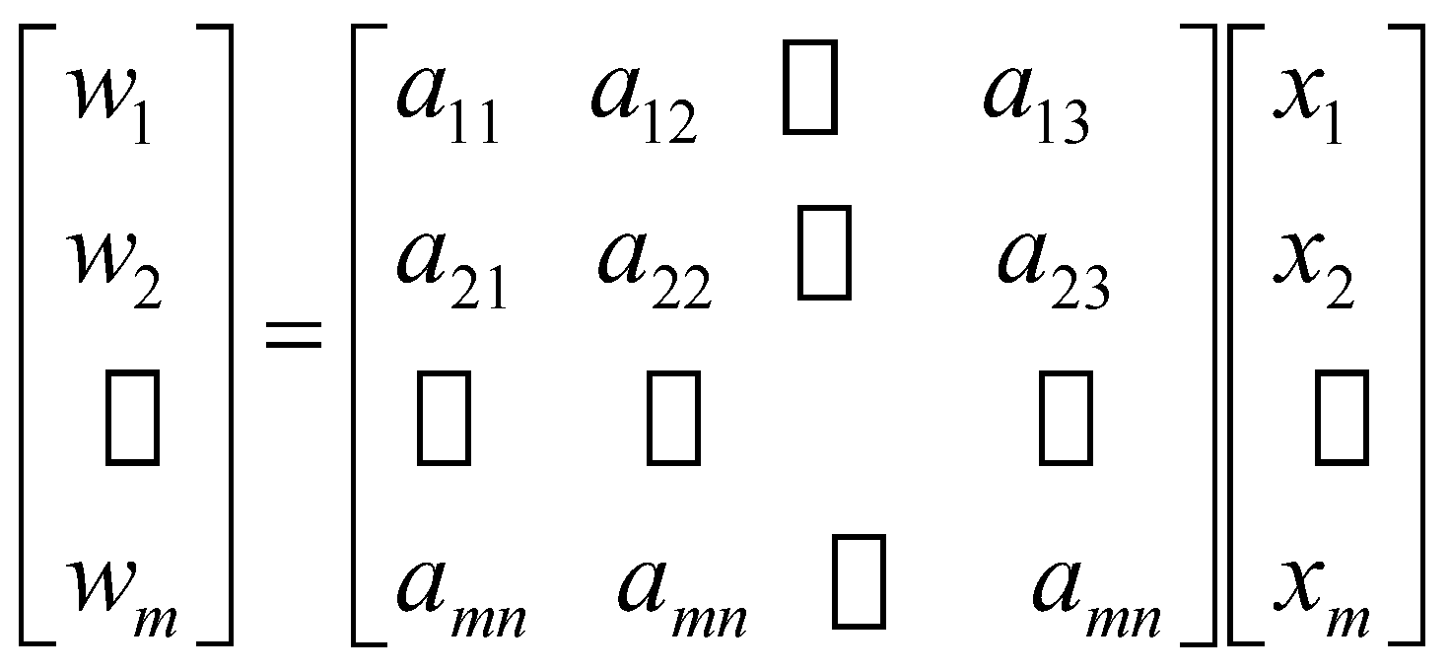
4-2 Linear Transformations from R^{n} to R^{m}
A linear transformation (or a linear operator if m = n) T: R^{n} → R^{m} is defined by equations of the form or or
w = Ax
The matrix A = [a_{ij}] is called the standard matrix for the linear transformation T, and T is called multiplication by A.
*
Elementary Linear Algebra
‹#›

Slide 22
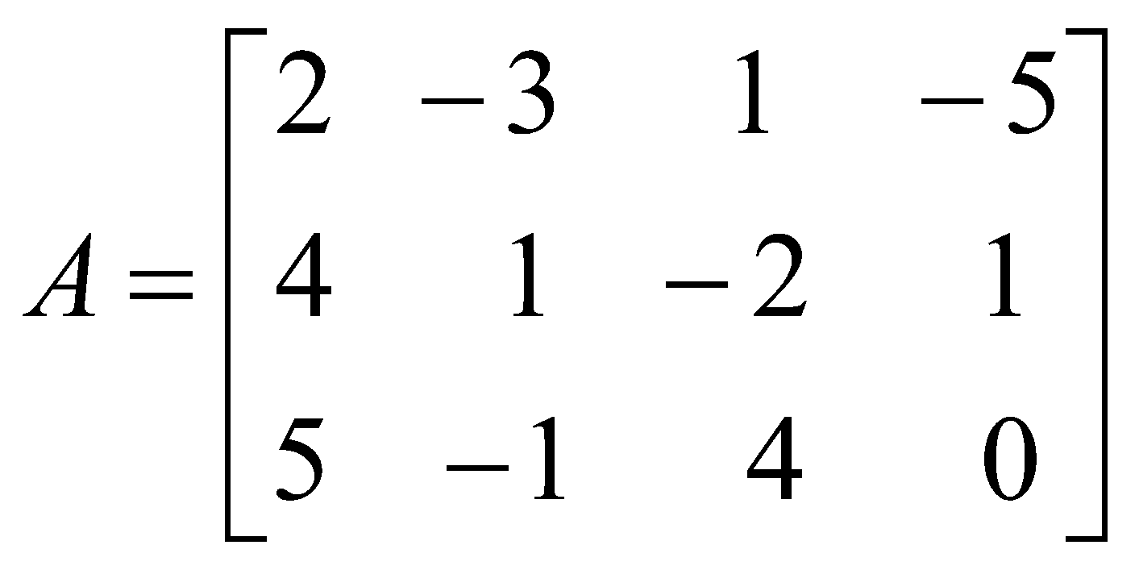
4-2 Example 2 (Linear Transformation)
The linear transformation T : R⁴ → R³ defined by the equations
w₁ = 2x₁ – 3x₂ + x₃ – 5x₄
w₂ = 4x₁ + x₂ – 2x₃ + x₄
w₃ = 5x₁ – x₂ + 4x₃
the standard matrix for T (i.e., w = Ax) is
*
Elementary Linear Algebra
‹#›

Slide 23
4-2 Notations of Linear Transformations
If it is important to emphasize that A is the standard matrix for T. We denote the linear transformation T: R^{n} → R^{m} by T_{A}: R^{n} → R^{m} . Thus, T_{A}(x) = Ax
We can also denote the standard matrix for T by the symbol [T], or T(x) = [T]x
Remark:
A correspondence between m×n matrices and linear transformations from R^{n} to R^{m} :
To each matrix A there corresponds a linear transformation T_{A} (multiplication by A), and to each linear transformation T: R^{n} → R^{m}, there corresponds an m×n matrix [T] (the standard matrix for T).
*
Elementary Linear Algebra
‹#›

Slide 24
4-2 Examples
Example 3 (Zero Transformation from R^{n} to R^{m})
If 0 is the m×n zero matrix and 0 is the zero vector in R^{n}, then for every vector x in R^{n}
T₀(x) = 0x = 0
So multiplication by zero maps every vector in R^{n} into the zero vector in R^{m}. We call T₀ the zero transformation from R^{n} to R^{m}.
Example 4 (Identity Operator on R^{n})
If I is the n×n identity, then for every vector in R^{n}
T_{I}(x) = Ix = x
So multiplication by I maps every vector in R^{n} into itself.
We call T_{I} the identity operator on R^{n}.
*
Elementary Linear Algebra
‹#›

Slide 25
4-2 Reflection Operators
In general, operators on R² and R³ that map each vector into its symmetric image about some line or plane are called reflection operators.
Such operators are linear.
*
Elementary Linear Algebra
‹#›

Slide 26
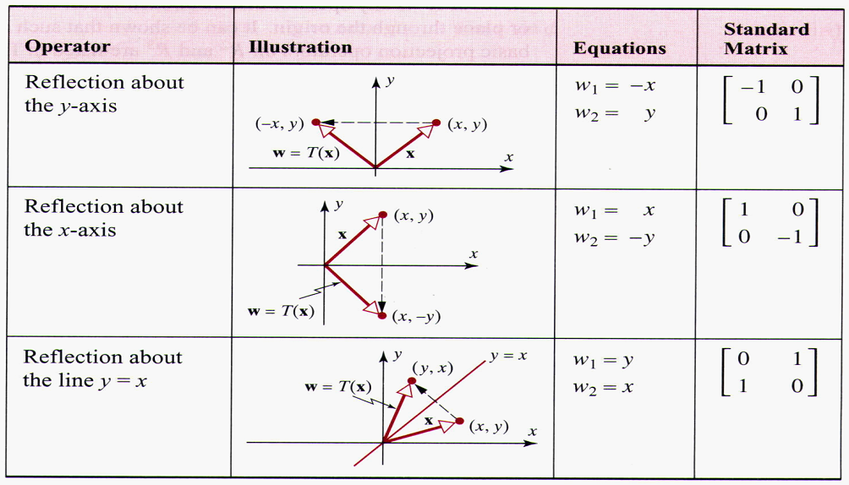
4-2 Reflection Operators (2-Space)
*
Elementary Linear Algebra
‹#›

Slide 27
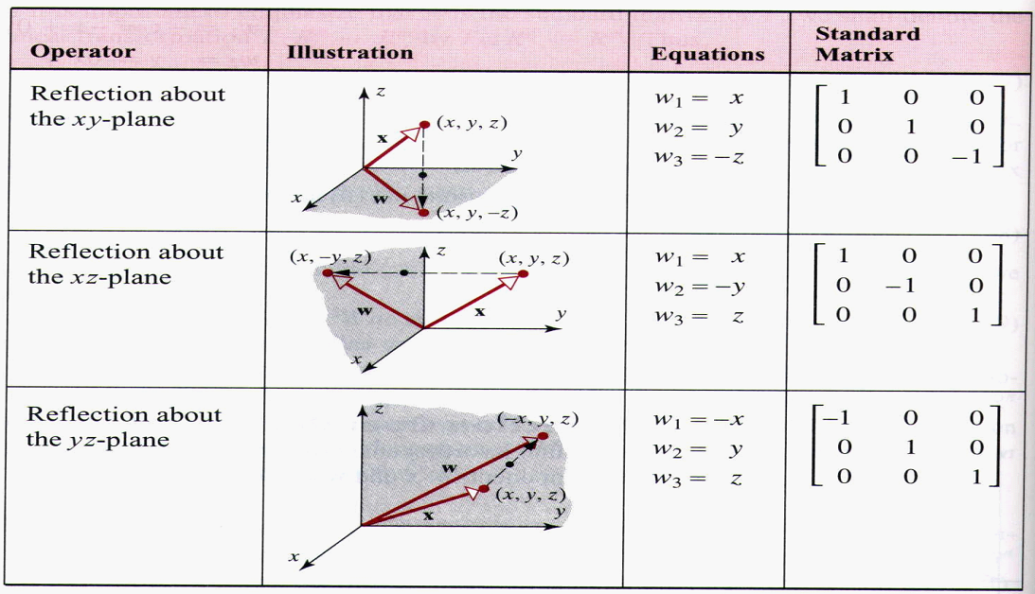
4-2 Reflection Operators (3-Space)
*
Elementary Linear Algebra
‹#›

Slide 28
4-2 Projection Operators
In general, a projection operator (or more precisely an orthogonal projection operator) on R² or R³ is any operator that maps each vector into its orthogonal projection on a line or plane through the origin.
The projection operators are linear.
*
Elementary Linear Algebra
‹#›

Slide 29
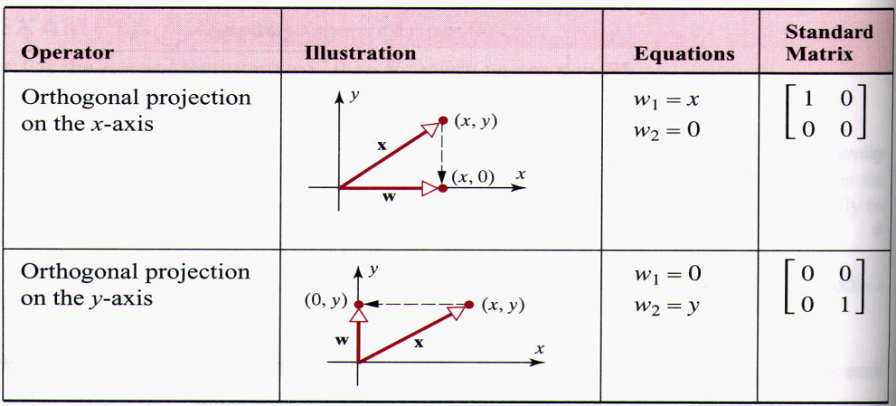
4-2 Projection Operators
*
Elementary Linear Algebra
‹#›

Slide 30
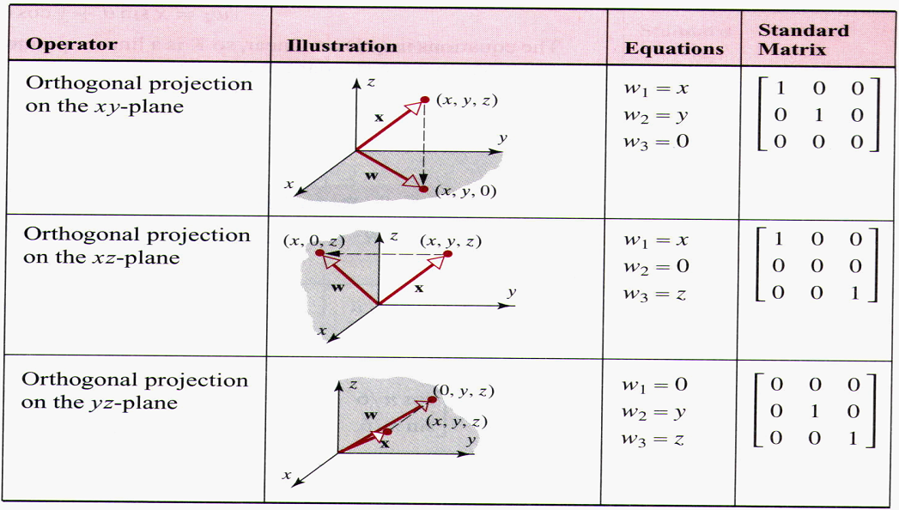
4-2 Projection Operators
*
Elementary Linear Algebra
‹#›

Slide 31
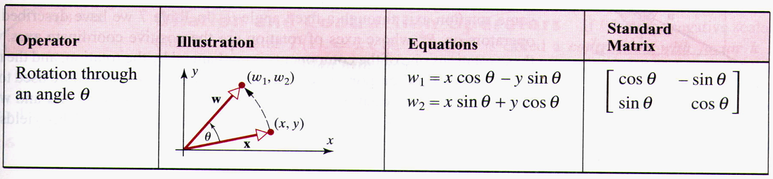
4-2 Rotation Operators
An operator that rotate each vector in R² through a fixed angle θ is called a rotation operator on R².
*
Elementary Linear Algebra
‹#›

Slide 32
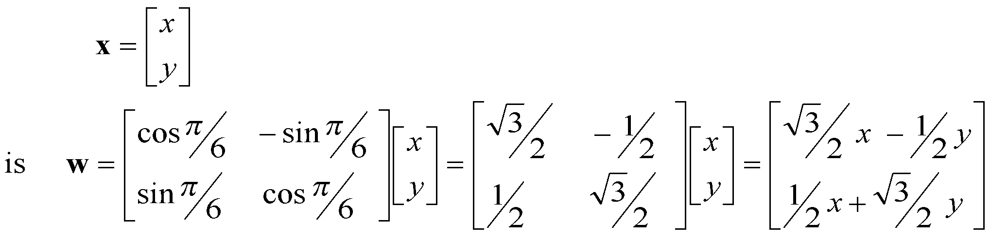
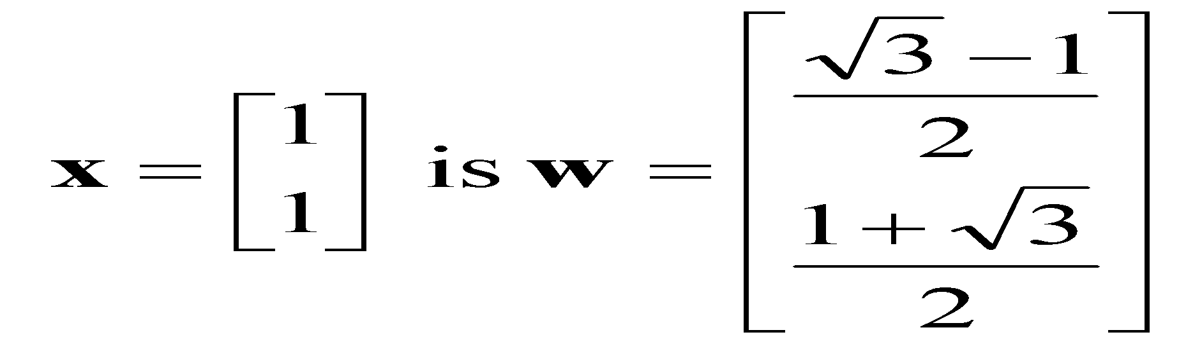
4-2 Example 6
If each vector in R² is rotated through an angle of π/6 (30°) ,then the image w of a vector
For example, the image of the vector
*
Elementary Linear Algebra
‹#›

Slide 33
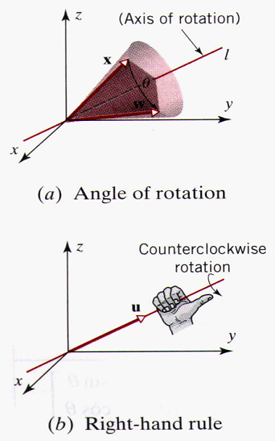
4-2 A Rotation of Vectors in R³
A rotation of vectors in R³ is usually described in relation to a ray emanating from the origin, called the axis of rotation.
As a vector revolves around the axis of rotation it sweeps out some portion of a cone.
The angle of rotation is described as “clockwise” or “counterclockwise” in relation to a viewpoint that is along the axis of rotation looking toward the origin.
The axis of rotation can be specified by a nonzero vector u that runs along the axis of rotation and has its initial point at the origin.
*
Elementary Linear Algebra
‹#›

Slide 34
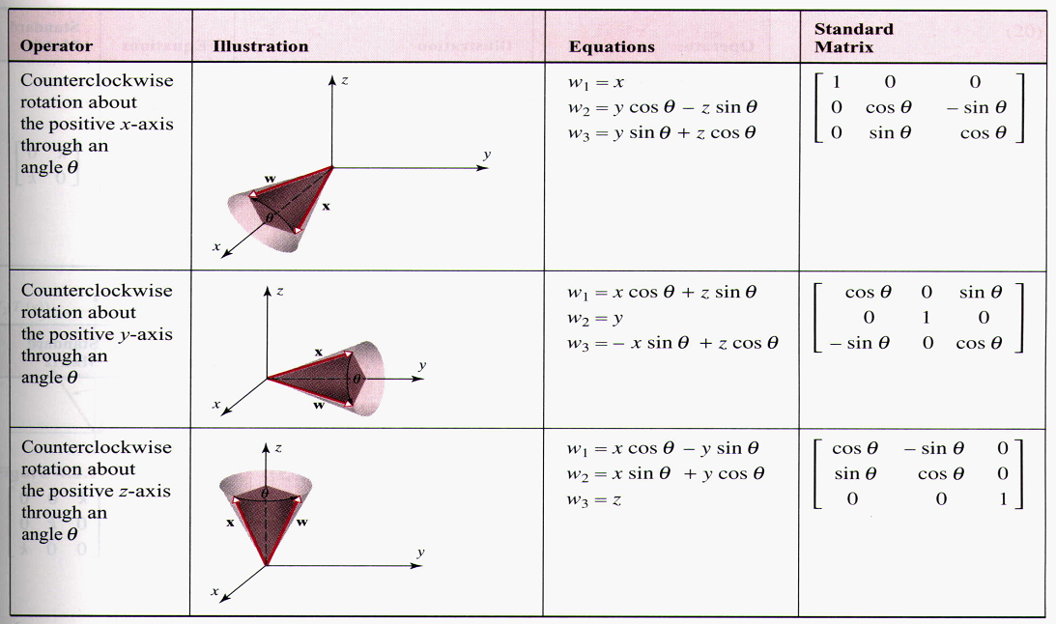
4-2 A Rotation of Vectors in R³
*
Elementary Linear Algebra
‹#›

Slide 35
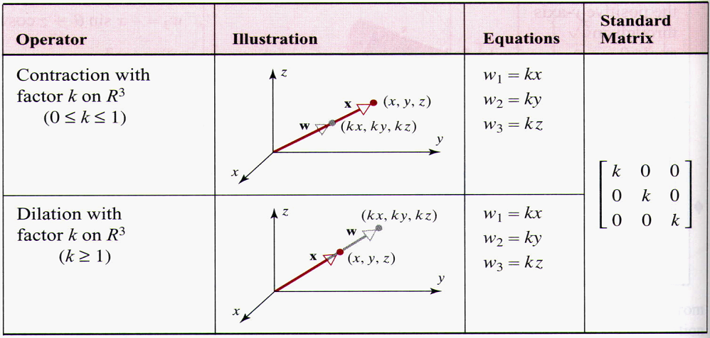
4-2 Dilation and Contraction Operators
If k is a nonnegative scalar, the operator on R² or R³ is called a contraction with factor k if 0 ≤ k ≤ 1 and a dilation with factor k if k ≥ 1 .
*
Elementary Linear Algebra
‹#›

Slide 36
4-2 Compositions of Linear Transformations
If T_{A} : R^{n} → R^{k} and T_{B} : R^{k} → R^{m} are linear transformations, then for each x in R^{n} one can first compute T_{A}(x), which is a vector in R^{k}, and then one can compute T_{B}(T_{A}(x)), which is a vector in R^{m}.
the application of T_{A} followed by T_{B} produces a transformation from R^{n} to R^{m}.
This transformation is called the composition of T_{B} with T_{A} and is denoted by T_{B}。T_{A}. Thus (T_{B} 。 T_{A})(x) = T_{B}(T_{A}(x))
The composition T_{B} 。 T_{A} is linear since
(T_{B} 。T_{A})(x) = T_{B}(T_{A}(x)) = B(Ax) = (BA)x
The standard matrix for T_{B}。T_{A} is BA. That is, T_{B}。T_{A} = T_{BA}
Multiplying matrices is equivalent to composing the corresponding linear transformations in the right-to-left order of the factors.
*
Elementary Linear Algebra
‹#›

Slide 37
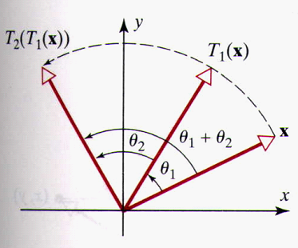
4-2 Example 6 (Composition of Two Rotations)
Let T₁ : R² → R² and T₂ : R² → R² be linear operators that rotate vectors through the angle θ₁ and θ₂, respectively.
The operation
(T₂ 。T₁)(x) = (T₂(T₁(x)))
first rotates x through the angle θ₁, then rotates T₁(x) through the angle θ₂.
It follows that the net effect of
T₂ 。T₁
is to rotate each vector in R² through the angle θ₁+ θ₂
*
Elementary Linear Algebra
‹#›

Slide 38
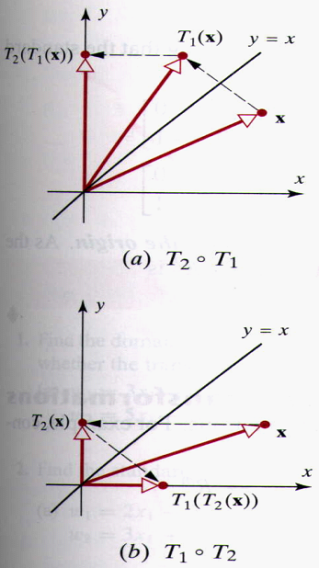
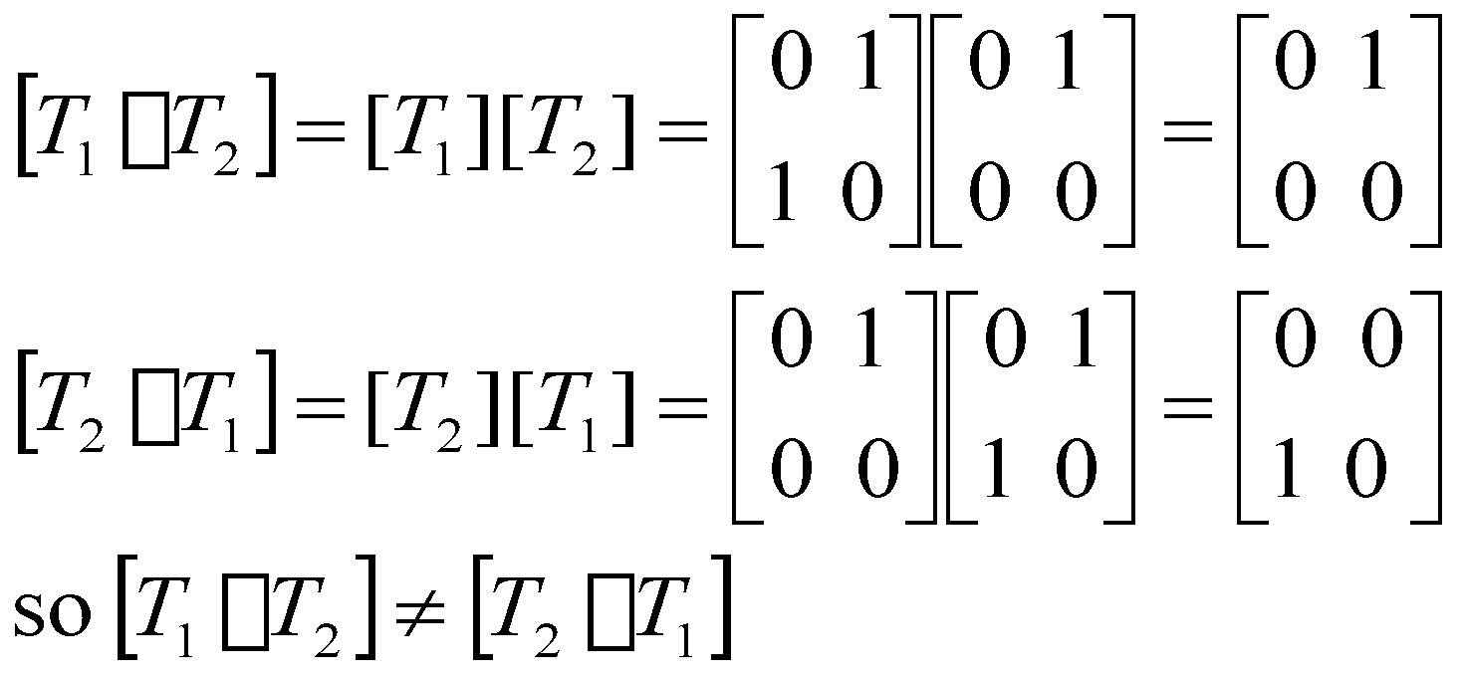
4-2 Example 7
Composition Is Not Commutative
*
Elementary Linear Algebra
‹#›

Slide 39
4-2 Example 8
Let T₁: R² → R² be the reflection about the y-axis, and T₂: R² → R² be the reflection about the x-axis.
(T₁◦T₂)(x,y) = T₁(x, -y) = (-x, -y)
(T₂◦T₁)(x,y) = T₂(-x, y) = (-x, -y)
is called the reflection about the origin
加圖4.2.9
*
Elementary Linear Algebra
‹#›

Slide 40
4-2 Compositions of Three or More Linear Transformations
Consider the linear transformations
T₁ : R^{n} → R^{k} , T₂ : R^{k} → R^{l} , T₃ : R^{l} → R^{m}
We can define the composition (T₃◦T₂◦T₁) : R^{n} → R^{m} by
(T₃◦T₂◦T₁)(x) : T₃(T₂(T₁(x)))
This composition is a linear transformation and the standard matrix for T₃◦T₂◦T₁ is related to the standard matrices for T₁,T₂, and T₃ by
[T₃◦T₂◦T₁] = [T₃][T₂][T₁]
If the standard matrices for T₁, T₂, and T₃ are denoted by A, B, and C, respectively, then we also have
T_{C}◦T_{B}◦T_{A} = T_{CBA}
*
Elementary Linear Algebra
‹#›

Slide 41
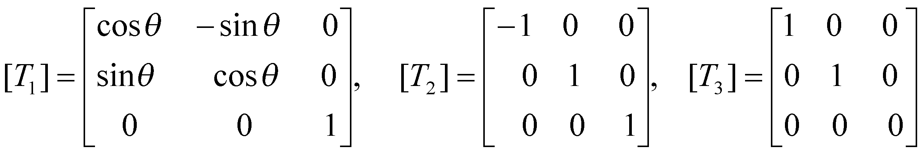
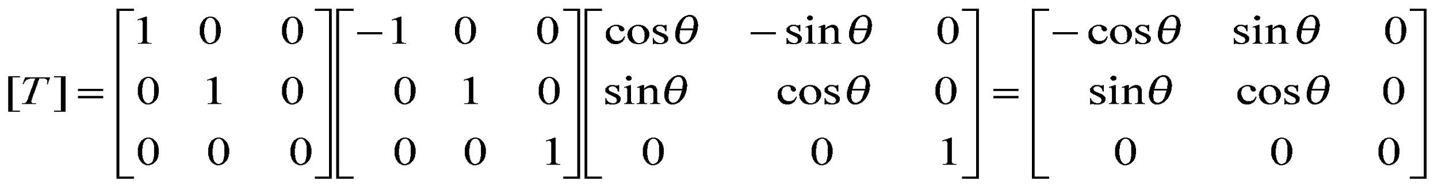
4-2 Example 9
Find the standard matrix for the linear operator T : R³ → R³ that first rotates a vector counterclockwise about the z-axis through an angle θ, then reflects the resulting vector about the yz-plane, and then projects that vector orthogonally onto the xy-plane.
*
Elementary Linear Algebra
‹#›

Slide 42
Chapter Content
Euclidean n-Space
Linear Transformations from R^{n} to R^{m}
Properties of Linear Transformations R^{n} to R^{m}
Linear Transformations and Polynomials
*
Elementary Linear Algebra
‹#›

Slide 43
4-3 One-to-One Linear Transformations
A linear transformation T : R^{n} →R^{m} is said to be one-to-one if T maps distinct vectors (points) in R^{n} into distinct vectors (points) in R^{m}
Remark:
That is, for each vector w in the range of a one-to-one linear transformation T, there is exactly one vector x such that T(x) = w.
Example 1
Rotation operator is one-to-one
Orthogonal projection operator is not one-to-one
*
Elementary Linear Algebra
‹#›

Slide 44
Theorem 4.3.1 (Equivalent Statements)
If A is an n×n matrix and T_{A} : R^{n} → R^{n} is multiplication by A, then the following statements are equivalent.
A is invertible
The range of T_{A} is R^{n}
T_{A} is one-to-one
*
Elementary Linear Algebra
‹#›

Slide 45
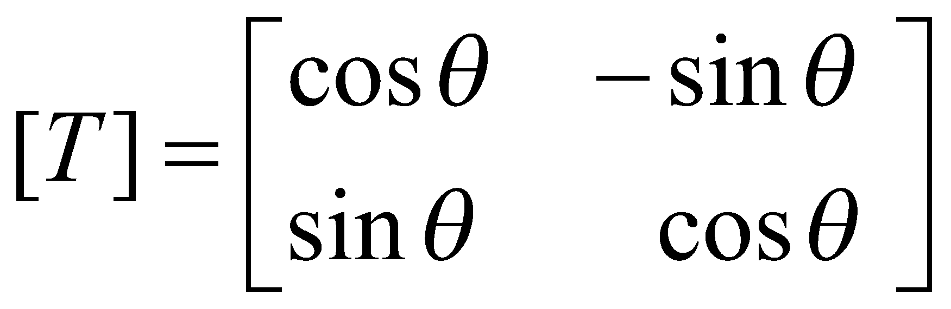
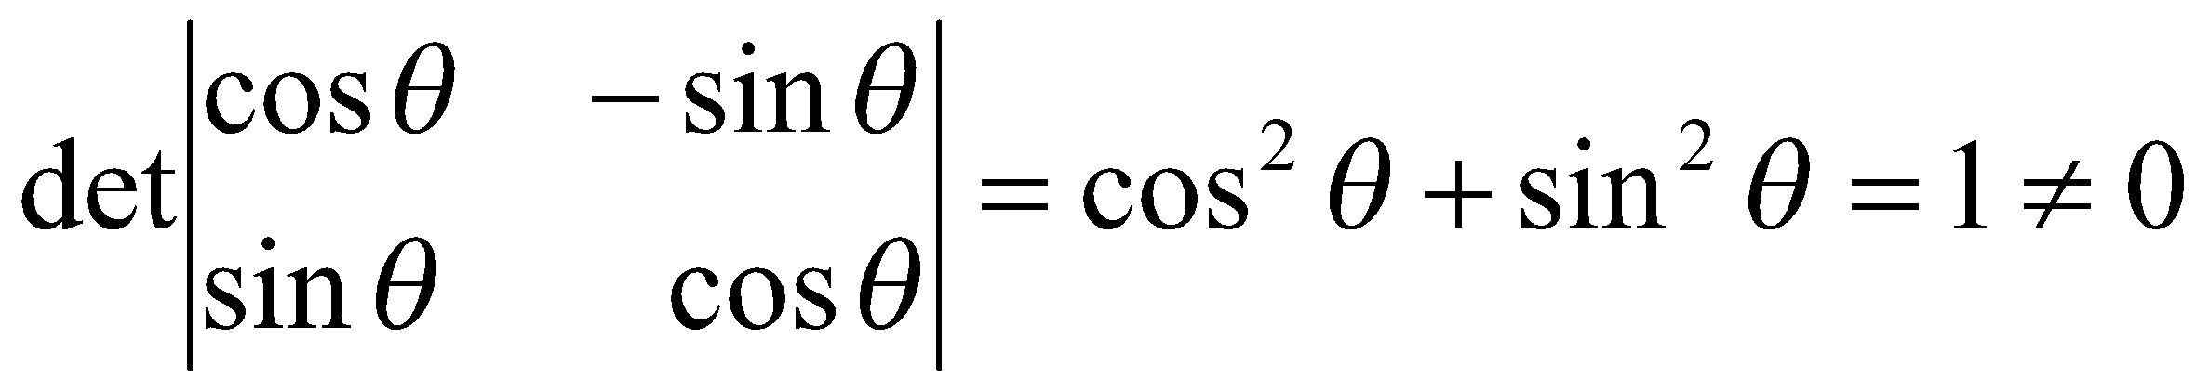
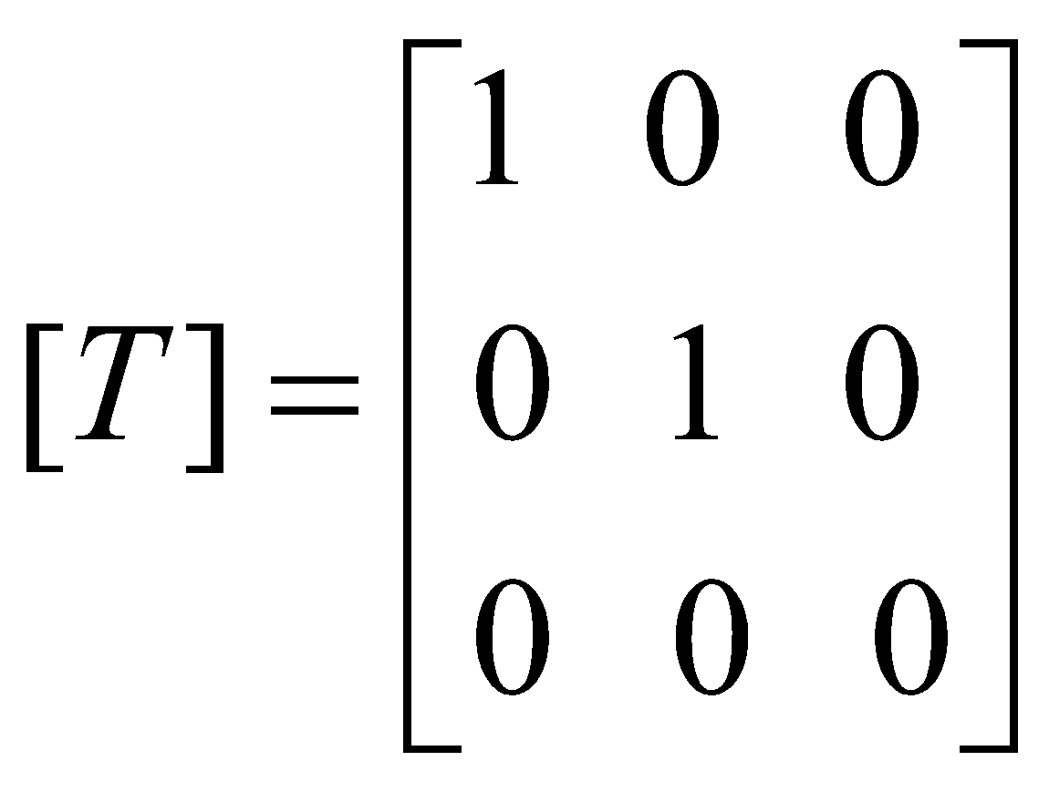
4-3 Example 2 & 3
The rotation operator T : R² → R² is one-to-one
The standard matrix for T is
[T] is invertible since
The projection operator T : R³ → R³ is not one-to-one
The standard matrix for T is
[T] is invertible since det[T] = 0
*
Elementary Linear Algebra
‹#›

Slide 46
4-3 Inverse of a One-to-One Linear Operator
Suppose T_{A} : R^{n} → R^{n} is a one-to-one linear operator
⇒ The matrix A is invertible.
⇒ T_{A}⁻¹ : R^{n} → R^{n} is itself a linear operator; it is called the inverse of T_{A}.
⇒ T_{A}(T_{A}⁻¹(x)) = AA⁻¹x = Ix = x and T_{A}⁻¹(T_{A} (x)) = A⁻¹Ax = Ix = x
⇒ T_{A} ◦ T_{A}⁻¹ = T_{AA}⁻¹ = T_{I} and T_{A}⁻¹ ◦ T_{A} = T_{A}⁻¹_{A} = T_{I}
If w is the image of x under T_{A}, then T_{A}⁻¹ maps w back into x, since
T_{A}⁻¹(w) = T_{A}⁻¹(T_{A} (x)) = x
When a one-to-one linear operator on R^{n} is written as T : R^{n} → R^{n}, then the inverse of the operator T is denoted by T⁻¹.
Thus, by the standard matrix, we have [T⁻¹]=[T]⁻¹
*
Elementary Linear Algebra
‹#›

Slide 47
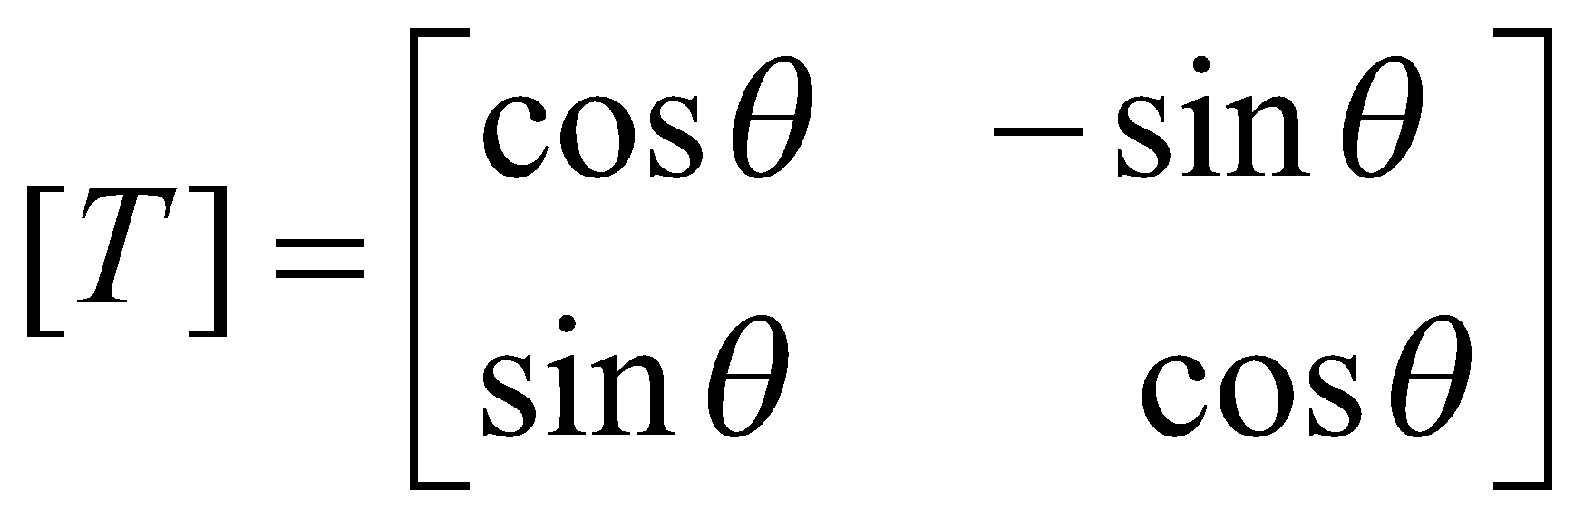
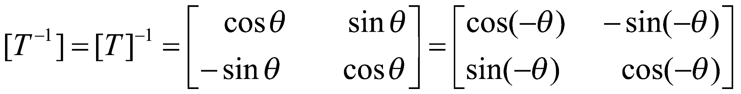
4-3 Example 4
Let T : R² → R² be the operator that rotates each vector in R² through the angle θ:
Undo the effect of T means rotate each vector in R² through the angle -θ.
This is exactly what the operator T⁻¹ does: the standard matrix T⁻¹ is
The only difference is that the angle θ is replaced by -θ
*
Elementary Linear Algebra
‹#›

Slide 48
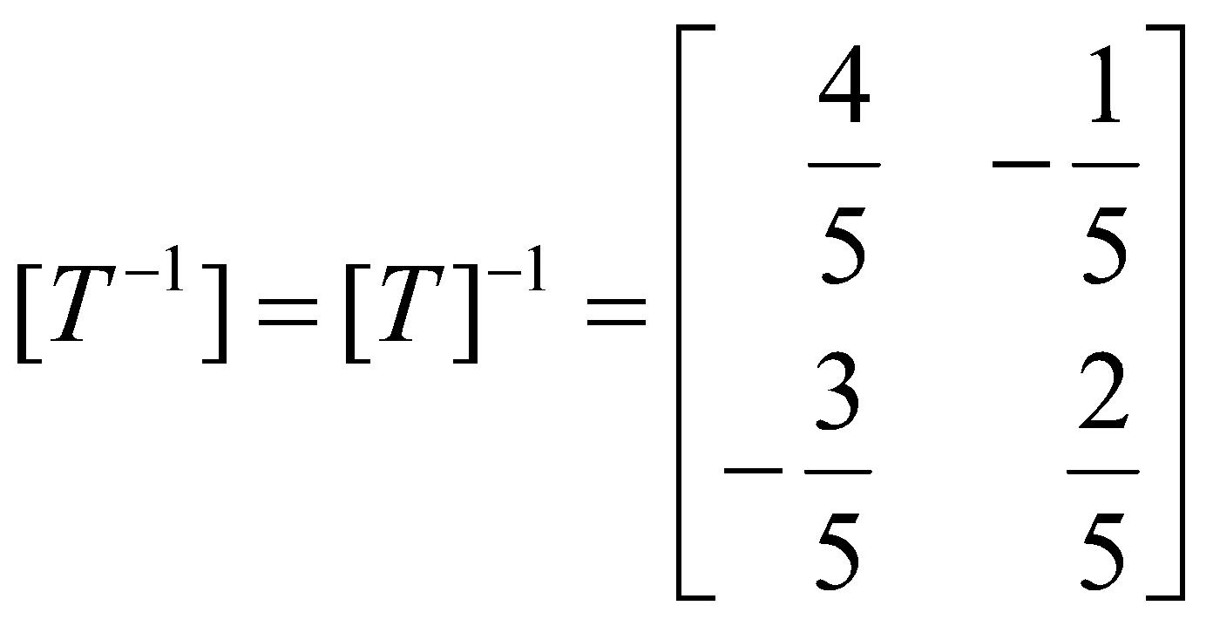
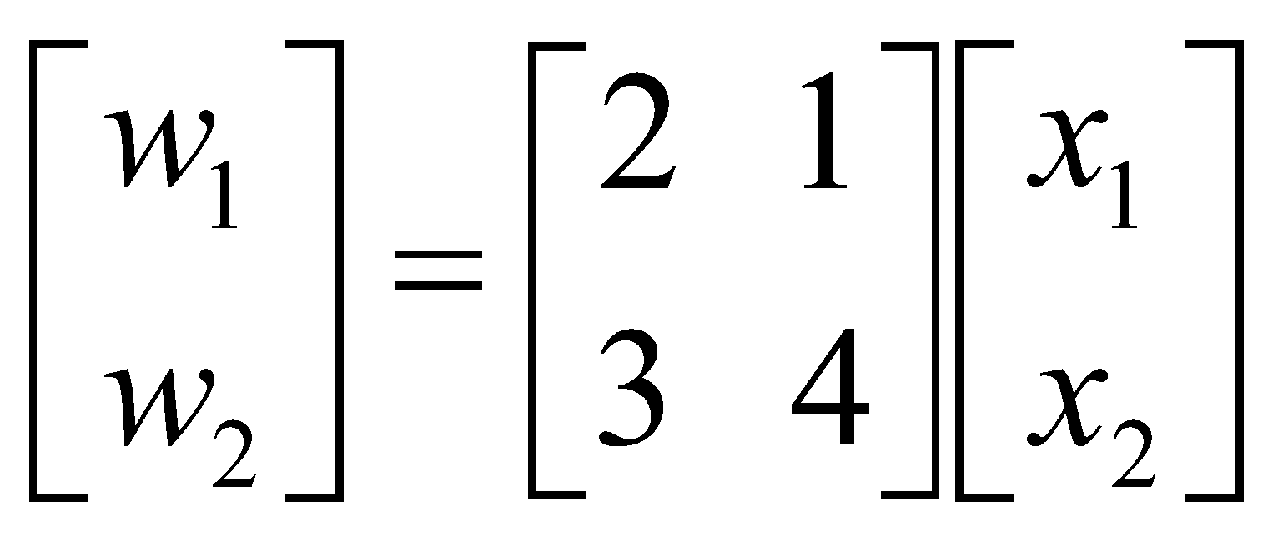
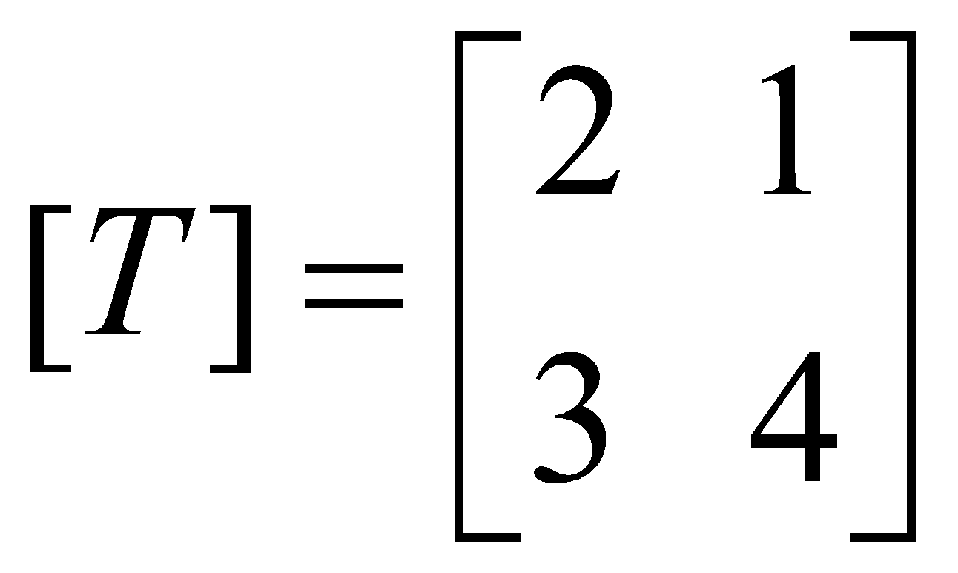
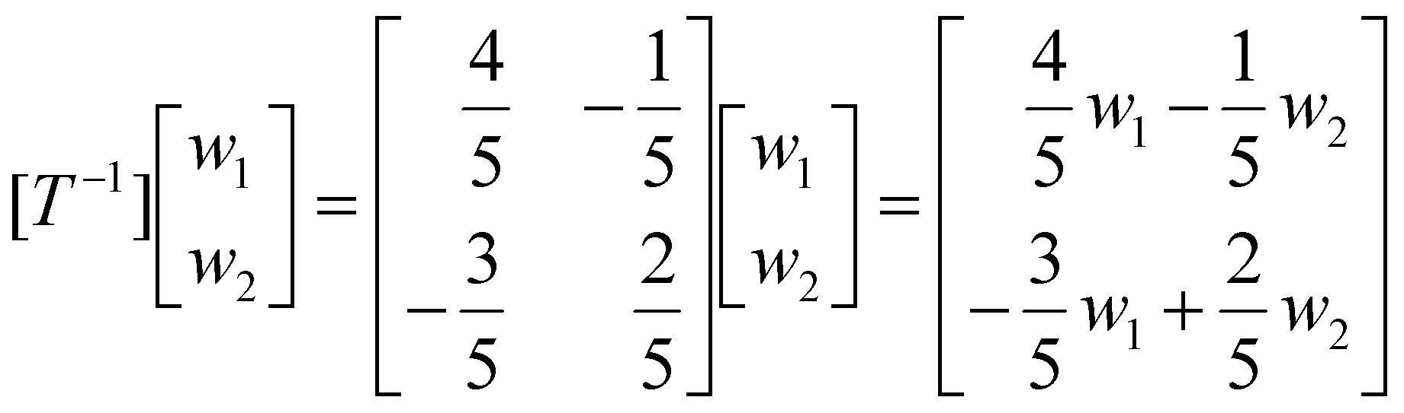
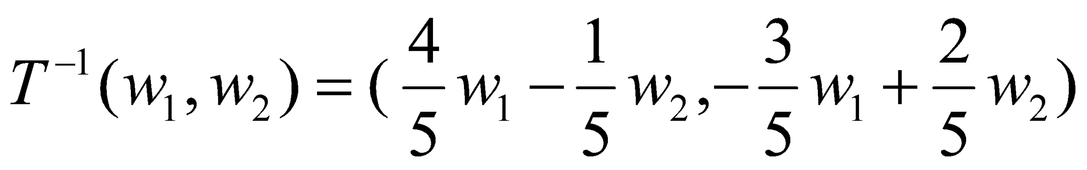
4-3 Example 5
Show that the linear operator T : R² → R² defined by the equations
w₁= 2x₁+ x₂
w₂ = 3x₁+ 4x₂
is one-to-one, and find T⁻¹(w₁,w₂).
Solution:
*
Elementary Linear Algebra
‹#›

Slide 49
Theorem 4.3.2 (Properties of Linear Transformations)
A transformation T : R^{n} → R^{m} is linear if and only if the following relationships hold for all vectors u and v in R^{n} and every scalar c.
T(u + v) = T(u) + T(v)
T(cu) = cT(u)
*
Elementary Linear Algebra
‹#›

Slide 50
Theorem 4.3.3
If T : R^{n} → R^{m} is a linear transformation, and e₁, e₂, …, e_{n} are the standard basis vectors for R^{n}, then the standard matrix for T is A = [T] = [T(e₁) | T(e₂) | … | T(e_{n})]
*
Elementary Linear Algebra
‹#›

Slide 51
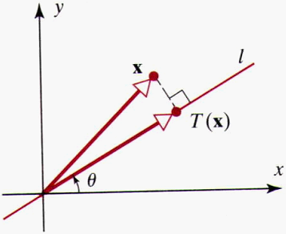
4-3 Example 6 (Standard Matrix for a Projection Operator)
Let l be the line in the xy-plane that passes through the origin and makes an angle θ with the positive x-axis, where 0 ≤ θ ≤ π. Let T: R² → R² be a linear operator that maps each vector into orthogonal projection on l.
Find the standard matrix for T.
Find the orthogonal projection of the vector x = (1,5) onto the line through the origin that makes an angle of θ = π/6 with the positive x-axis.
*
Elementary Linear Algebra
‹#›

Slide 52
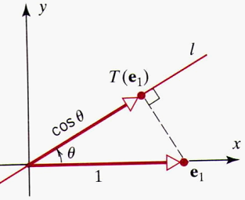
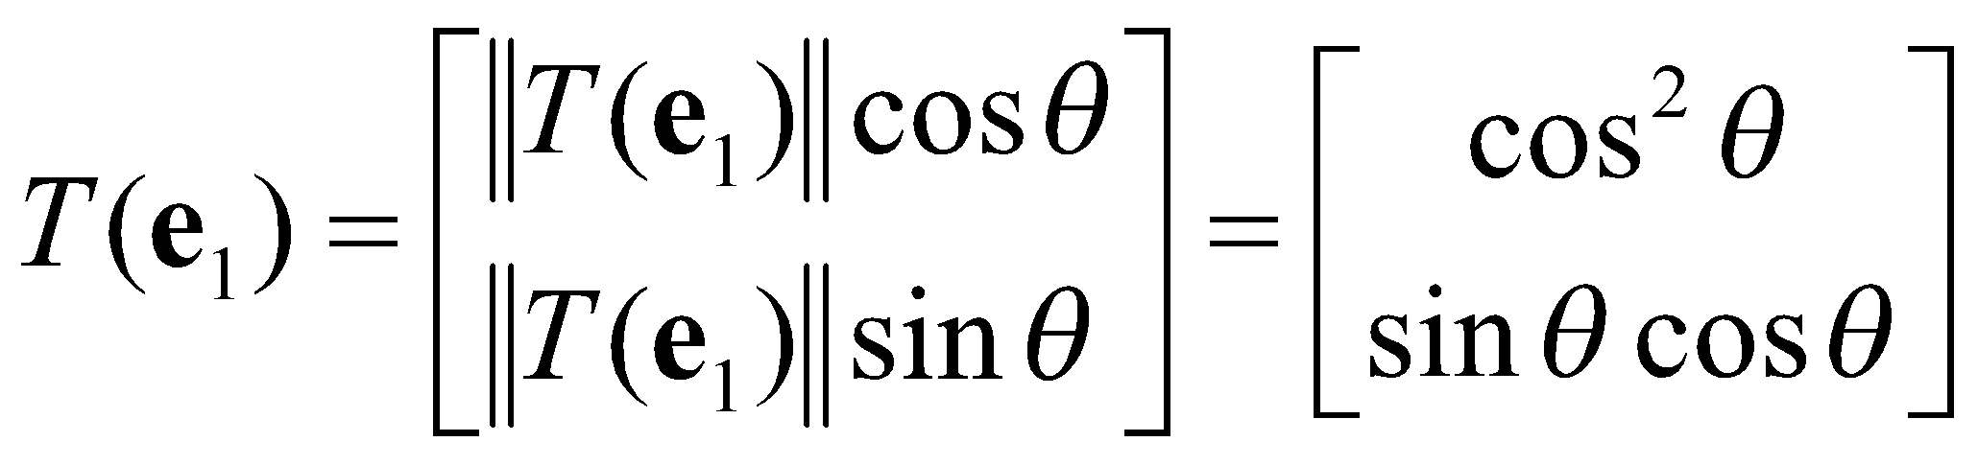
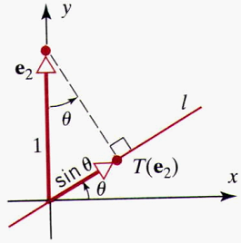
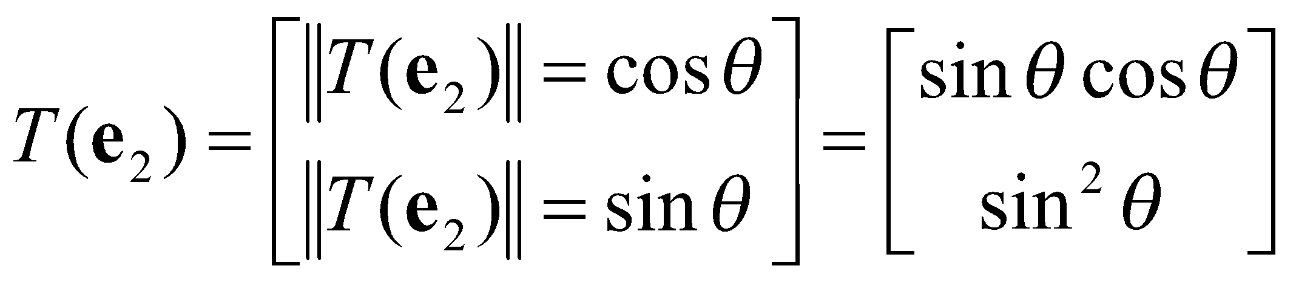
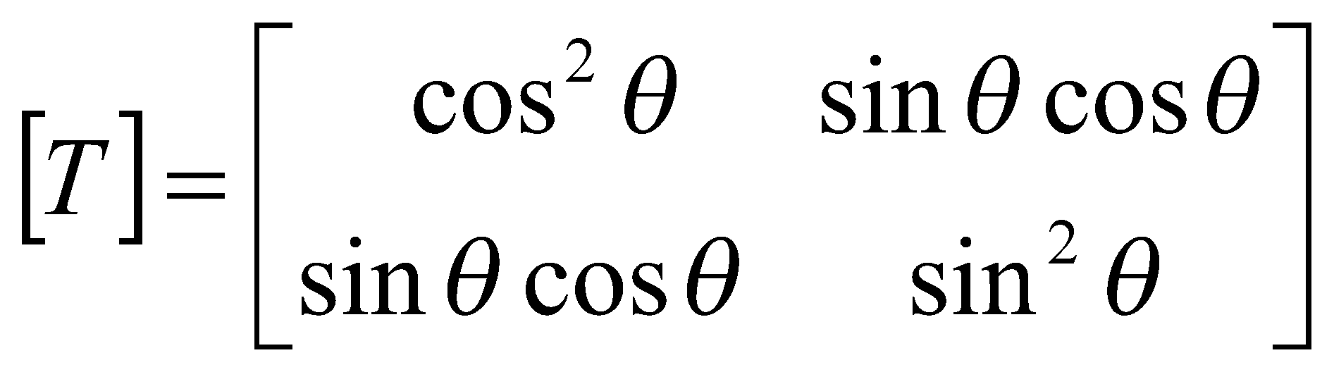
4-3 Example 6 (continue)
The standard matrix for T can be written as
[T] = [T(e₁) | T(e₂)]
Consider the case 0 ≤ θ ≤ π/2.
||T(e₁)|| = cos θ
||T(e₂)|| = sin θ
*
Elementary Linear Algebra
‹#›

Slide 53
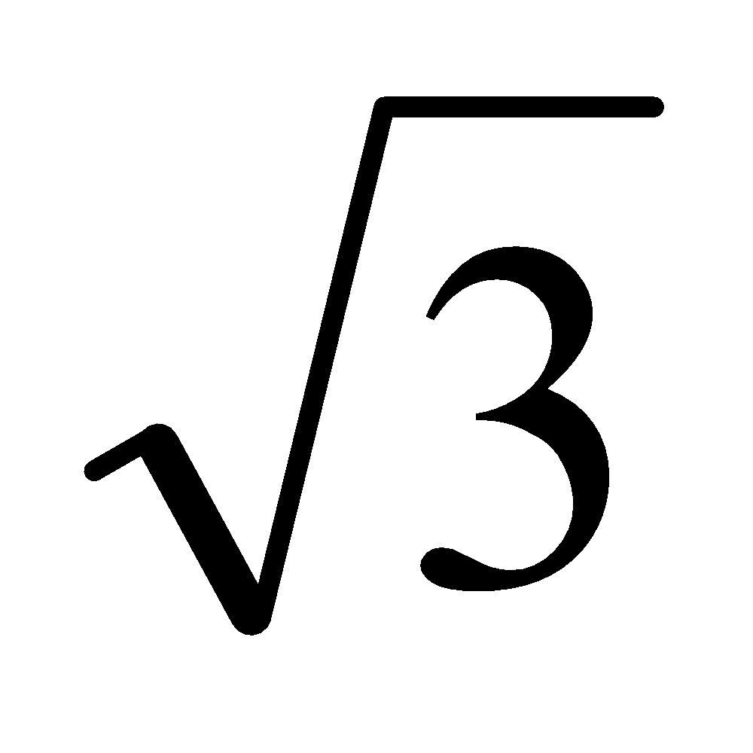


4-3 Example 6 (continue)
Since sin (π/6) = 1/2 and cos (π/6) = /2, it follows from part (a) that the standard matrix for this projection operator is
Thus,
*
Elementary Linear Algebra
‹#›

